Slide 1
Introduction
Name: Kashyap Pathak
Enrollment No: 92000133029
Topic: Mask Detection Project
Subject: Artificial Intelligence
Branch: ICT
Sem: 6
Guided By: Prof. Nishith Kotak

Slide 2
Introduction:Mask Detection
In this project we have used Opencv,tensorflow,keras,cnn,rnn and some concepts of ai
We can import many libraries to plot graph and computation ,like SciPy, matplotlib ,numpy,imutilsand etc..
Also we can collect the images like with mask and with out mask Dataset and then we can perform image classifications And perform computations train models and at last we can see whether it is detect the mask or not.
This project helps in covid-19 and also some of places. Where mask is compulsory.

Slide 3
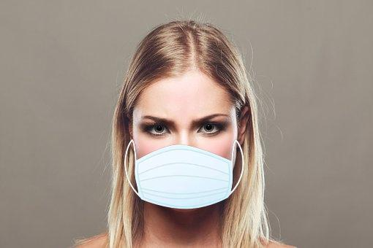
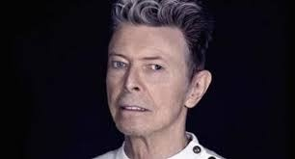
Objectives
In this project we can create face mask detector and train the Mask using NumPy, OpenCV , keras, TensorFlow And topic of ai like neural network , RNN and etc..
To create face mask detector , we trained to class of model of people wearing mask and people not wearing mask.
We can give path and import the dataset. Then obtain classifier that is accurate. We use libraries or computations.
Then we detecting faces in images.
Extracting each and individual face
Applying our classifier and after complete all computation we detect the mask whether it is wear or not. Also we can see when shadow is come on the face then mask is wearied or not. that is our overall objective.
With Mask And
Without Mask

Slide 4
Libraries for detect mask image
from tensorflow.keras.applications.mobilenet_v2 import preprocess_input
from tensorflow.keras.preprocessing.image import img_to_array //for image processing
from tensorflow.keras.models import load_model
import numpy as np
import argparse
import cv2
import os

Slide 5
Library used in train the mask
from tensorflow.keras.preprocessing.image import ImageDataGenerator
from tensorflow.keras.applications import MobileNetV2
from tensorflow.keras.layers import AveragePooling2D
from tensorflow.keras.layers import Dropout
from tensorflow.keras.layers import Flatten
from tensorflow.keras.layers import Dense
from tensorflow.keras.layers import Input
from tensorflow.keras.models import Model
from tensorflow.keras.optimizers import Adam
from tensorflow.keras.applications.mobilenet_v2 import preprocess_input
from tensorflow.keras.preprocessing.image import img_to_array
from tensorflow.keras.preprocessing.image import load_img
from tensorflow.keras.utils import to_categorical
from sklearn.preprocessing import LabelBinarizer
from sklearn.model_selection import train_test_split
from sklearn.metrics import classification_report
from imutils import paths
import matplotlib.pyplot as plt
import numpy as np
import argparse
import os

Slide 6
Requirements of this library
tensorflow>=2.5.0*
keras==2.4.3
imutils==0.5.4
numpy==1.19.5
opencvpython>=4.2.0.32
matplotlib==3.4.1
argparse==1.4.0
scipy==1.6.2
scikit-learn==0.24.1
pillow>=8.3.2s
treamlit==0.79.
0onnx==1.10.1tf2onnx==1.9.3

Slide 7
Python File List
i need to create mask detection using real time videos and using Particular image.
So for that I need to create detect_mask_image.py
For real time videos I need to create detect_mask_video.py
For Train The Mask I Need to Create train_mask_detector.py

Slide 8
Code Of Mask Detection
# USAGE
# python detect_mask_video.py
# import the necessary packages
from tensorflow.keras.applications.mobilenet_v2 import preprocess_input
from tensorflow.keras.preprocessing.image import img_to_array
from tensorflow.keras.models import load_model
from imutils.video import VideoStream
import numpy as np
import argparse
import imutils
import time
import cv2
import os
def detect_and_predict_mask(frame, faceNet, maskNet):
# grab the dimensions of the frame and then construct a blob
# from it
(h, w) = frame.shape[:2]
blob = cv2.dnn.blobFromImage(frame, 1.0, (300, 300),
(104.0, 177.0, 123.0))
# pass the blob through the network and obtain the face detections
faceNet.setInput(blob)
detections = faceNet.forward()
# initialize our list of faces, their corresponding locations,
# and the list of predictions from our face mask network
faces = []
locs = []

Slide 9
preds = [] # loop over the detections for i in range(0, detections.shape[2]): # extract the confidence (i.e., probability) associated with # the detection confidence = detections[0, 0, i, 2] # filter out weak detections by ensuring the confidence is # greater than the minimum confidence if confidence > args["confidence"]: # compute the (x, y)-coordinates of the bounding box for # the object box = detections[0, 0, i, 3:7] * np.array([w, h, w, h]) (startX, startY, endX, endY) = box.astype("int") # ensure the bounding boxes fall within the dimensions of # the frame (startX, startY) = (max(0, startX), max(0, startY)) (endX, endY) = (min(w - 1, endX), min(h - 1, endY)) # extract the face ROI, convert it from BGR to RGB channel # ordering, resize it to 224x224, and preprocess it face = frame[startY:endY, startX:endX] if face.any(): face = cv2.cvtColor(face, cv2.COLOR_BGR2RGB) face = cv2.resize(face, (224, 224)) face = img_to_array(face) face = preprocess_input(face) # add the face and bounding boxes to their respective # lists

Slide 10
faces.append(face) locs.append((startX, startY, endX, endY)) # only make a predictions if at least one face was detected if len(faces) > 0: # for faster inference we'll make batch predictions on *all* # faces at the same time rather than one-by-one predictions # in the above `for` loop faces = np.array(faces, dtype="float32") preds = maskNet.predict(faces, batch_size=32) # return a 2-tuple of the face locations and their corresponding # locations return (locs, preds) # construct the argument parser and parse the arguments ap = argparse.ArgumentParser() ap.add_argument("-f", "--face", type=str, default="face_detector", help="path to face detector model directory") ap.add_argument("-m", "--model", type=str, default="mask_detector.model", help="path to trained face mask detector model") ap.add_argument("-c", "--confidence", type=float, default=0.5, help="minimum probability to filter weak detections") args = vars(ap.parse_args()) # load our serialized face detector model from disk print("[INFO] loading face detector model...") prototxtPath = os.path.sep.join([args["face"], "deploy.prototxt"]) weightsPath = os.path.sep.join([args["face"], "res10_300x300_ssd_iter_140000.caffemodel"]) faceNet = cv2.dnn.readNet(prototxtPath, weightsPath) # load the face mask detector model from disk print("[INFO] loading face mask detector model...") maskNet = load_model(args["model"])

Slide 11
# initialize the video stream and allow the camera sensor to warm up print("[INFO] starting video stream...") vs = VideoStream(src=0).start() time.sleep(2.0) # loop over the frames from the video stream while True: # grab the frame from the threaded video stream and resize it # to have a maximum width of 400 pixels frame = vs.read() frame = imutils.resize(frame, width=400) # detect faces in the frame and determine if they are wearing a # face mask or not (locs, preds) = detect_and_predict_mask(frame, faceNet, maskNet) # loop over the detected face locations and their corresponding # locations for (box, pred) in zip(locs, preds): # unpack the bounding box and predictions (startX, startY, endX, endY) = box (mask, withoutMask) = pred # determine the class label and color we'll use to draw # the bounding box and text label = "Mask" if mask > withoutMask else "No Mask" color = (0, 255, 0) if label == "Mask" else (0, 0, 255) # include the probability in the label label = "{}: {:.2f}%".format(label, max(mask, withoutMask) * 100)

Slide 12
# display the label and bounding box rectangle on the output # frame cv2.putText(frame, label, (startX, startY - 10), cv2.FONT_HERSHEY_SIMPLEX, 0.45, color, 2) cv2.rectangle(frame, (startX, startY), (endX, endY), color, 2) # show the output frame cv2.imshow("Frame", frame) key = cv2.waitKey(1) & 0xFF # if the `q` key was pressed, break from the loop if key == ord("q"): break # do a bit of cleanup cv2.destroyAllWindows() vs.stop()

Slide 13
# USAGE # python detect_mask_image.py --image images/pic1.jpeg # import the necessary packages from tensorflow.keras.applications.mobilenet_v2 import preprocess_input from tensorflow.keras.preprocessing.image import img_to_array from tensorflow.keras.models import load_model import numpy as np import argparse import cv2 import os def mask_image(): # construct the argument parser and parse the arguments ap = argparse.ArgumentParser() ap.add_argument("-i", "--image", required=True, help="path to input image") ap.add_argument("-f", "--face", type=str, default="face_detector", help="path to face detector model directory") ap.add_argument("-m", "--model", type=str, default="mask_detector.model", help="path to trained face mask detector model") ap.add_argument("-c", "--confidence", type=float, default=0.5, help="minimum probability to filter weak detections") args = vars(ap.parse_args()) # load our serialized face detector model from disk print("[INFO] loading face detector model...") prototxtPath = os.path.sep.join([args["face"], "deploy.prototxt"]) weightsPath = os.path.sep.join([args["face"], "res10_300x300_ssd_iter_140000.caffemodel"]) net = cv2.dnn.readNet(prototxtPath, weightsPath) # load the face mask detector model from disk print("[INFO] loading face mask detector model...") model = load_model(args["model"])
For Image

Slide 14
blob = cv2.dnn.blobFromImage(image, 1.0, (300, 300), (104.0, 177.0, 123.0)) # pass the blob through the network and obtain the face detections print("[INFO] computing face detections...") net.setInput(blob) detections = net.forward() # loop over the detections for i in range(0, detections.shape[2]): # extract the confidence (i.e., probability) associated with # the detection confidence = detections[0, 0, i, 2] # filter out weak detections by ensuring the confidence is # greater than the minimum confidence if confidence > args["confidence"]: # compute the (x, y)-coordinates of the bounding box for # the object box = detections[0, 0, i, 3:7] * np.array([w, h, w, h]) (startX, startY, endX, endY) = box.astype("int") # ensure the bounding boxes fall within the dimensions of # the frame (startX, startY) = (max(0, startX), max(0, startY)) (endX, endY) = (min(w - 1, endX), min(h - 1, endY)) # extract the face ROI, convert it from BGR to RGB channel # ordering, resize it to 224x224, and preprocess it face = image[startY:endY, startX:endX] face = cv2.cvtColor(face, cv2.COLOR_BGR2RGB) face = cv2.resize(face, (224, 224)) face = img_to_array(face) face = preprocess_input(face) face = np.expand_dims(face, axis=0) # pass the face through the model to determine if the face # has a mask or not (mask, withoutMask) = model.predict(face)[0]

Slide 15
label = "Mask" if mask > withoutMask else "No Mask" color = (0, 255, 0) if label == "Mask" else (0, 0, 255) # include the probability in the label label = "{}: {:.2f}%".format(label, max(mask, withoutMask) * 100) # display the label and bounding box rectangle on the output # frame cv2.putText(image, label, (startX, startY - 10), cv2.FONT_HERSHEY_SIMPLEX, 0.45, color, 2) cv2.rectangle(image, (startX, startY), (endX, endY), color, 2) # show the output image cv2.imshow("Output", image) cv2.waitKey(0) if __name__ == "__main__": mask_image()

Slide 16
# USAGE # python train_mask_detector.py --dataset dataset # import the necessary packages from tensorflow.keras.preprocessing.image import ImageDataGenerator from tensorflow.keras.applications import MobileNetV2 from tensorflow.keras.layers import AveragePooling2D from tensorflow.keras.layers import Dropout from tensorflow.keras.layers import Flatten from tensorflow.keras.layers import Dense from tensorflow.keras.layers import Input from tensorflow.keras.models import Model from tensorflow.keras.optimizers import Adam from tensorflow.keras.applications.mobilenet_v2 import preprocess_input from tensorflow.keras.preprocessing.image import img_to_array from tensorflow.keras.preprocessing.image import load_img from tensorflow.keras.utils import to_categorical from sklearn.preprocessing import LabelBinarizer from sklearn.model_selection import train_test_split from sklearn.metrics import classification_report from imutils import paths import matplotlib.pyplot as plt import numpy as np import argparse import os # construct the argument parser and parse the arguments ap = argparse.ArgumentParser() ap.add_argument("-d", "--dataset", required=True, help="path to input dataset") ap.add_argument("-p", "--plot", type=str, default="plot.png", help="path to output loss/accuracy plot") ap.add_argument("-m", "--model", type=str, default="mask_detector.model", help="path to output face mask detector model") args = vars(ap.parse_args())
Train the mask

Slide 17
INIT_LR = 1e-4 EPOCHS = 20 BS = 32 # grab the list of images in our dataset directory, then initialize # the list of data (i.e., images) and class images print("[INFO] loading images...") imagePaths = list(paths.list_images(args["dataset"])) data = [] labels = [] # loop over the image paths for imagePath in imagePaths: # extract the class label from the filename label = imagePath.split(os.path.sep)[-2] # load the input image (224x224) and preprocess it image = load_img(imagePath, target_size=(224, 224)) image = img_to_array(image) image = preprocess_input(image) # update the data and labels lists, respectively data.append(image) labels.append(label) # convert the data and labels to NumPy arrays data = np.array(data, dtype="float32") labels = np.array(labels) # perform one-hot encoding on the labels lb = LabelBinarizer() labels = lb.fit_transform(labels) labels = to_categorical(labels) # partition the data into training and testing splits using 75% of # the data for training and the remaining 25% for testing (trainX, testX, trainY, testY) = train_test_split(data, labels,

Slide 18
test_size=0.20, stratify=labels, random_state=42) # construct the training image generator for data augmentation aug = ImageDataGenerator( rotation_range=20, zoom_range=0.15, width_shift_range=0.2, height_shift_range=0.2, shear_range=0.15, horizontal_flip=True, fill_mode="nearest") # load the MobileNetV2 network, ensuring the head FC layer sets are # left off baseModel = MobileNetV2(weights="imagenet", include_top=False, input_tensor=Input(shape=(224, 224, 3))) # construct the head of the model that will be placed on top of the # the base model headModel = baseModel.output headModel = AveragePooling2D(pool_size=(7, 7))(headModel) headModel = Flatten(name="flatten")(headModel) headModel = Dense(128, activation="relu")(headModel) headModel = Dropout(0.5)(headModel) headModel = Dense(2, activation="softmax")(headModel) # place the head FC model on top of the base model (this will become # the actual model we will train) model = Model(inputs=baseModel.input, outputs=headModel) # loop over all layers in the base model and freeze them so they will # *not* be updated during the first training process for layer in baseModel.layers: layer.trainable = False # compile our model print("[INFO] compiling model...") opt = Adam(lr=INIT_LR, decay=INIT_LR / EPOCHS) model.compile(loss="binary_crossentropy", optimizer=opt, metrics=["accuracy"])

Slide 19
# train the head of the network print("[INFO] training head...") H = model.fit( aug.flow(trainX, trainY, batch_size=BS), steps_per_epoch=len(trainX) // BS, validation_data=(testX, testY), validation_steps=len(testX) // BS, epochs=EPOCHS) # make predictions on the testing set print("[INFO] evaluating network...") predIdxs = model.predict(testX, batch_size=BS) # for each image in the testing set we need to find the index of the # label with corresponding largest predicted probability predIdxs = np.argmax(predIdxs, axis=1) # show a nicely formatted classification report print(classification_report(testY.argmax(axis=1), predIdxs, target_names=lb.classes_)) # serialize the model to disk print("[INFO] saving mask detector model...") model.save(args["model"], save_format="h5") # plot the training loss and accuracy N = EPOCHS plt.style.use("ggplot") plt.figure() plt.plot(np.arange(0, N), H.history["loss"], label="train_loss") plt.plot(np.arange(0, N), H.history["val_loss"], label="val_loss") plt.plot(np.arange(0, N), H.history["accuracy"], label="train_acc") plt.plot(np.arange(0, N), H.history["val_accuracy"], label="val_acc") plt.title("Training Loss and Accuracy") plt.xlabel("Epoch #") plt.ylabel("Loss/Accuracy") plt.legend(loc="lower left") plt.savefig(args["plot"])

Slide 20
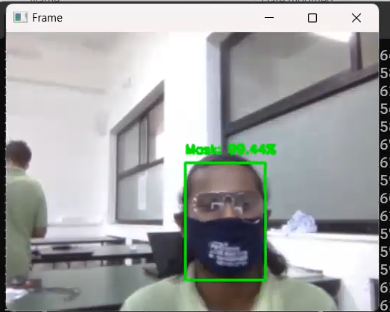
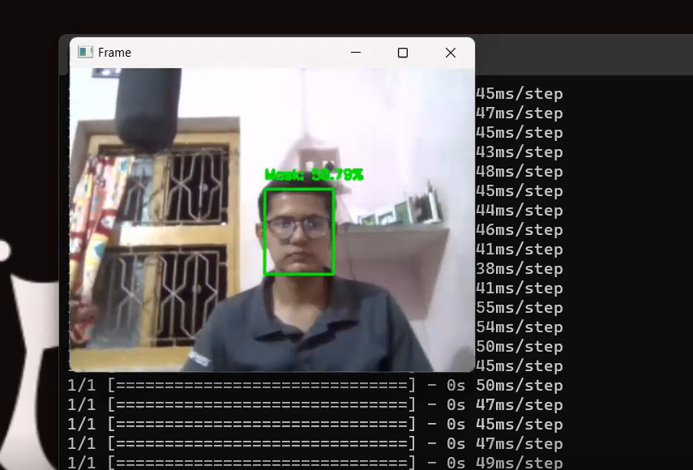
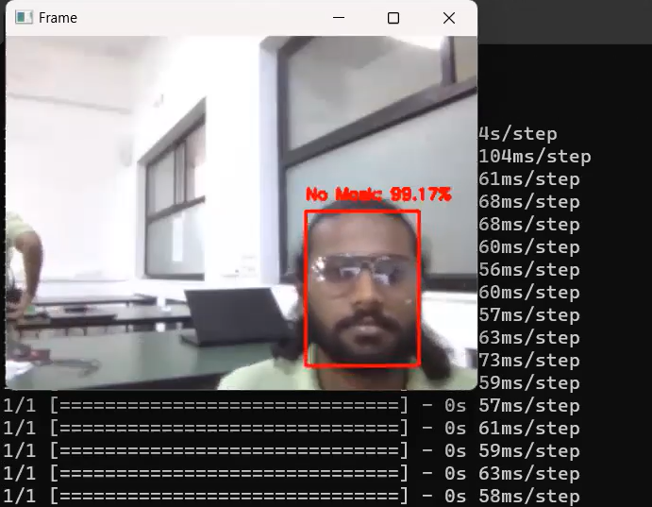
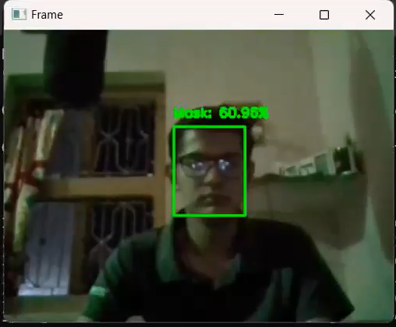
Accuracy
Bearded Cases
Shadow Detection
Image With Accuracy in shadow and Mask

Slide 21

Video of Bearde in Mask detection

Slide 22
Video for shadow in mask detection

Slide 23
Thank You
Guided By: Prof.Nishith Kotak

